Slide 1
DIGITAL & AGILE SUPPLY CHAIN
IN THE ERA OF DISRUPTION
Alberto Proverbio
Supply Chain Expert

Slide 2



THE AGE OF DISRUPTION:
growing Complexity and Demand Volatility
Managing Global Supply Chains has become increasingly difficult, with numerous challenges impacting how organizations ensure product availability, service levels, quality, sustainability and total cost optimization.
Rapidly Shifting Market Dynamics
Poor Supply Chain Visibility
Static Planning Processes
Bottlenecks, increased costs, unplanned events and risks,
growing Demand Volatility,
People challenges
70% of companies don’t know their n-level supplier network (survey by Resilinc)
Out of touch with reality,
based on no updated data

Slide 3



THE ANSWER
AGILE AND RESILIENT SUPPLY CHAIN
With the goal of enabling strategic business growth, companies must implement new supply chain models focused on collaboration, extended visibility, adaptability, sustainability and enabled by Digital Tech
Digital Collaboration
Extended Visibility
Digital Supply Chain Twin
Adaptable to Changes
Engages every level of the supply chain to ensure open flow and exchange of information
It’s a digital representation of the
physical supply chain (critical part) that can be used to create plans and make decisions
Speed and flexibility to react to sudden demand and supply changes. Anticipate risks

Slide 4
THE ANSWER
AGILE AND RESILIENT SUPPLY CHAIN
Multi-channel Collaboration with Business Partners
Real time/Network
Visibility
Closed loop between Planning & Execution
Key Points
Proactive Risk management
End to End Control Tower
Look Forward Forecasting
Near shoring/
Friendshoring
Tech
Machine learning/AI
IOT
Real time Location system
Augmented Reality
Big Data
Cloud

Slide 5
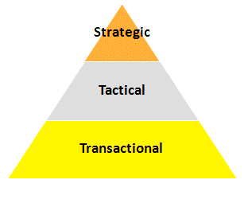
SUPPLY CHAIN COLLABORATION
Supply Chain Collaboration involves exchanging supply chain data between business partners through multiple digital channels (i.e. cloud based collab. platform) and covers different time frames
Business Partners
Strategic
Common metrics
Collaborative Planning Long term
Distributors/Customers
Collaborative Product development
Suppliers
Collaborative Sustainability
Tactical
Collaborative Capacity mgmt
external Manufacturers
Shared KPI/
SLA
Collaboration degree
Collaborative Forecasting (shared)
Logistics providers
Collaborative Replenishment/VMI
Collaborative Transportation Planning
Data providers
Transactional
Inventory Visibility
Order mgmt
Sell-out
Call-off
Logistics
events/risks
ASN
Master Data
Alignment
Invoice mgmt
Time

Slide 6
SUPPLY CHAIN VISIBILITY
Network and Dynamic
Collaboration with Business Partners and integration with the field (IOT) enables extended Supply Chain Visibility (Digital Supply Chain Twin)
Where Suppliers (N level) are located and where they produce and where procure material
Main logistics routes from Suppliers and to Customers
Real Lead times and other parameters
Supplier and Customers potential risks
….
NETWORK VISIBILITY
EXTENDED SUPPLY CHAIN VISIBILITY
Where are the Products
Inventory levels at Customers and Suppliers
Disruptions are affecting my logistics network
How plants are running
….
DYNAMIC REAL TIME VISIBILITY

Slide 7
CLOSED LOOP BETWEEN PLANNING AND EXECUTION
Digital Collaboration enables a new paradigm, closing the loop between Planning and Execution, short and medium time horizons, ensuring maximum speed to react to unplanned events and demand volatility
SUPPLY CHAIN EXECUTION
SUPPLY CHAIN PLANNING
SUPPLY CHAIN EXECUTION
SUPPLY CHAIN PLANNING
INTEGRATED SUPPLY CHAIN & PREDICTIVE PLANNING
E2E CONTROL TOWER
SUPPLY CHAIN PLANNING
LONG
DYNAMIC SALES & OPERATIONS PLANNING
DASHBOARD
RAPID
REPLANNING
RAPID
REPLANNING
HORIZONTAL
IMPACT ANALYSIS
CLOSED LOOP
PLANNING & EXECUTION
(short and medium horizon)
MEDIUM
RISK DETECTION
& ANALYSIS
SHORT
REAL-TIME RISKS & ISSUES DETECTION/ PROACTIVE ALERTING
EXTENDED REAL TIME VISIBILITY &
FIELD CONNECTION
SIMULATION
SUPPLY CHAIN EXECUTION
-
PRESCRIPTIONS
MULTI-CHANNEL COLLABORATION WITH BUSINESS PARTNERS
TACTICAL
COLLABORATION
REAL TIME

Slide 8
END TO END CONTROL TOWER
6. Sustainability reporting (Scope 1, 2, 3)
A supply chain Control Tower is a framework combining people, process, data and organization, facilitated by appropriately combined technology elements. Typically by functional domain.
It establishes a Central Hub to capture and use data, structured and unstructured, internal and external, to provide enhanced visibility and more and more predictions and suggestions for short-term and mid-term decision making
Evolution to an End to End (Horizontal) Control Tower
5. Horizontal Impact Analysis, Scenario Simulation, Prescriptions
4. Supply Chain Risk Detection & Management
BUILDING
BLOCKS
2. Dashboard, KPI & Root cause analysis
3. Alerts & Incidents Management
1. SC Network map
0. Data gathering & storing
Execution Collaboration with Business Partners
IOT events
ERP/MES
External sources (for country risks, weather risks, supplier risks, … )

Slide 9
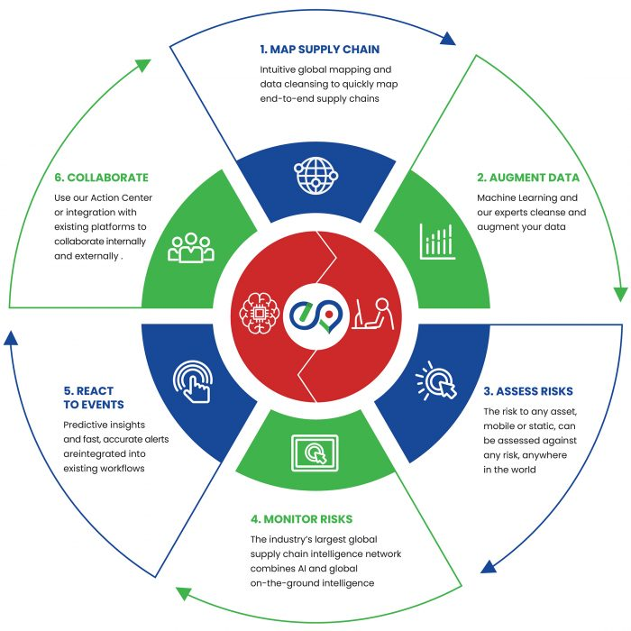
A structured supply chain risk management process with a clear Governance
SUPPLY CHAIN RISK MANAGEMENT
Map logistics and manufacturing network
Collaborate with suppliers and business partner to extend visibility on N-level network
Assess and gather risks at country, geographic area, logistics node, supplier, leveraging internal and external sources of information
Classify risks based on probability, impact and TTR = time to recover
Monitor and detect risk in real time, with early warning-alert
Mitigation actions (proactive, reactive)

Slide 10
WHERE WE ARE?
A stress test for Supply Chain
Supply Chain Performance & Resilience Assessment is a stress test method already applied to several companies to evaluate performances (vs best practices) and identify weakness and opportunities
https://www.industry4business.it/industria-4-0/come-effettuare-uno-stress-test-per-supply-chain-agili-e-resilienti/

Slide 11
WHERE WE ARE?
Results of stress test
Average performance = 3 (from 1 to 6)
Poor Visibility
Limited info about delays/ETA
Collaboration with traditional methods
Demand forecasting issues (looking at the past)
Fragmentation of Responsabilities of Supply Chain / Silo approach
Shortage of skills (cross-functional, new tech)
Slow to react
Important space for Improvement, enabling Growth
+ product availability
+ service level
+ customer satisfaction
- CO2 emissions
- cost of disruption
- low value added tasks

